Slide 1
Unpacking the Algorithms That Shape Our UX: Algorithmic Awareness as a Form of Information Literacy
Welcome!
Sunday, October 14th
1:30pm-3:30pm
Notes:
Jason

Slide 2
Outline
Introduction
Algorithm and Algorithmic Awareness
Questions
Breakout Session - Programming the Library
ACRL Framework
Algorithms in Action
First principles of algorithms
Design exercise
Notes:
Jason
Introduction- 20mins
Why should we care? 5 mins
Pseudo code exercise- 20mins
Continue to develop competency - Introduce first principles of algorithms reference document listing common algorithms and their placement (15 mins) - slides
Design exercises to get them thinking about implementation locally (35 minutes)

Slide 3
About Us
Jason Clark
Research Assistant
Tyler Bass
Research Assistant,
Julian Kaptanian
Associate Professor,
History of Science and Technology Undergraduate Student
Head of Archival Informatics and Special Collections, Montana State University
Computer Science Undergraduate Student
Notes:
Jason and Julian

Slide 4
Grant Overview
We routinely engage in systems that predict, recommend, and speculate about our interests but how and why do those systems work as they do?
Institute of Museum and Library Services: Laura Bush 21 Century Librarian Program
Deliverables
White Paper
Syllabus
Definitions of an algorithm
Breakout Session
Pseudo code example
Reading list
Teaching Tool
https://www.imls.gov/grants/awarded/re-72-17-0103-17
Notes:
Jason

Slide 5
Learning Objectives
Create actionable steps for teaching about algorithms in information literacy instruction
Learn how algorithms mediate digital experiences
Understand the invisible rules and processes embedded in software
Notes:
Julian
-note that we're going to release these slides and might skim through some content but we want to build a foundation in learning about algorithms that mediate difital experiences

Slide 6
Part 1: Learning and Understanding Algorithms
Notes:
Julian

Slide 7
An Algorithm Is...
"a set of instructions that makes machines do something automatically according to a condition"
Notes:
Julian

Slide 8
The Challenge of a Definition
Matthew Reidsma claims a simple interpretation of a complex idea perpetuates misunderstanding.
...a large set of binary choices that create a "decision tree" based upon many variables that are not necessarily apparent to the user.
Notes:
Julian

Slide 9
Algorithmic Awareness
“an understanding around the rules that govern our software and shape our digital experiences”
How Our Research Has Developed
Notes:
Julian

Slide 10
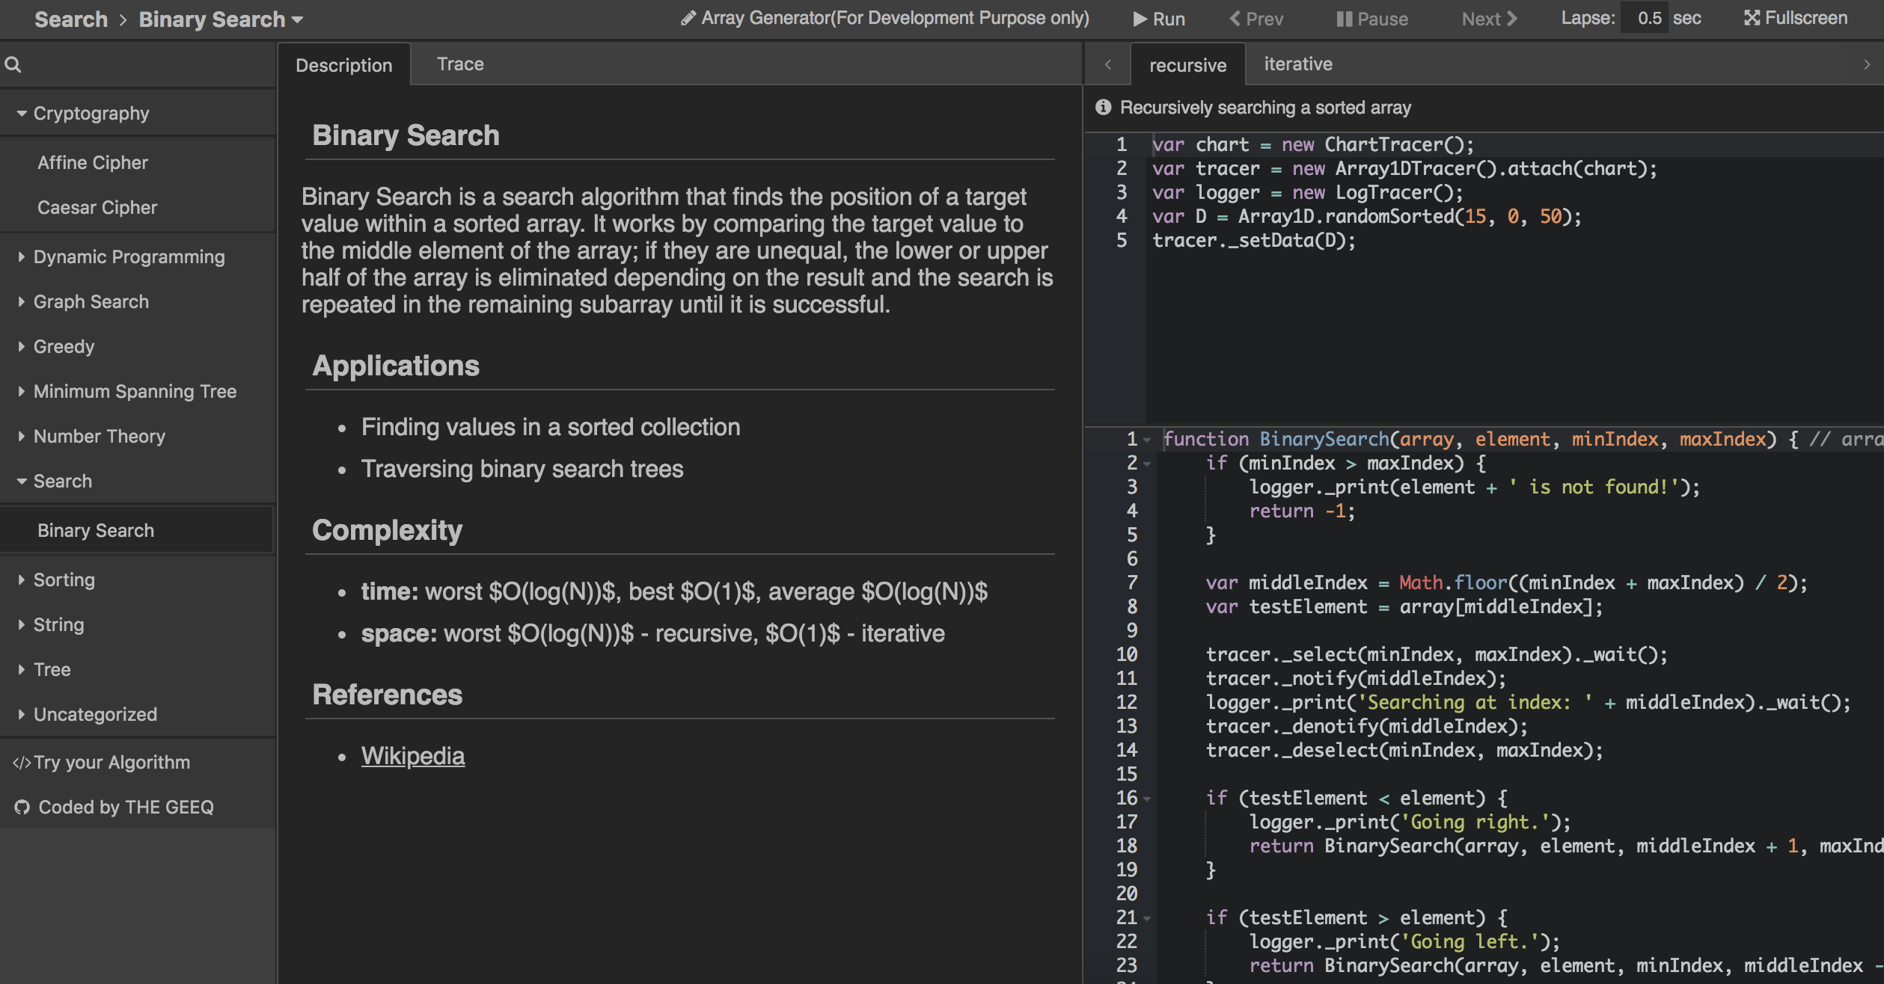
Algorithms are Complex
http://algonimator.thegeeq.gq/
Notes:
Julian

Slide 11
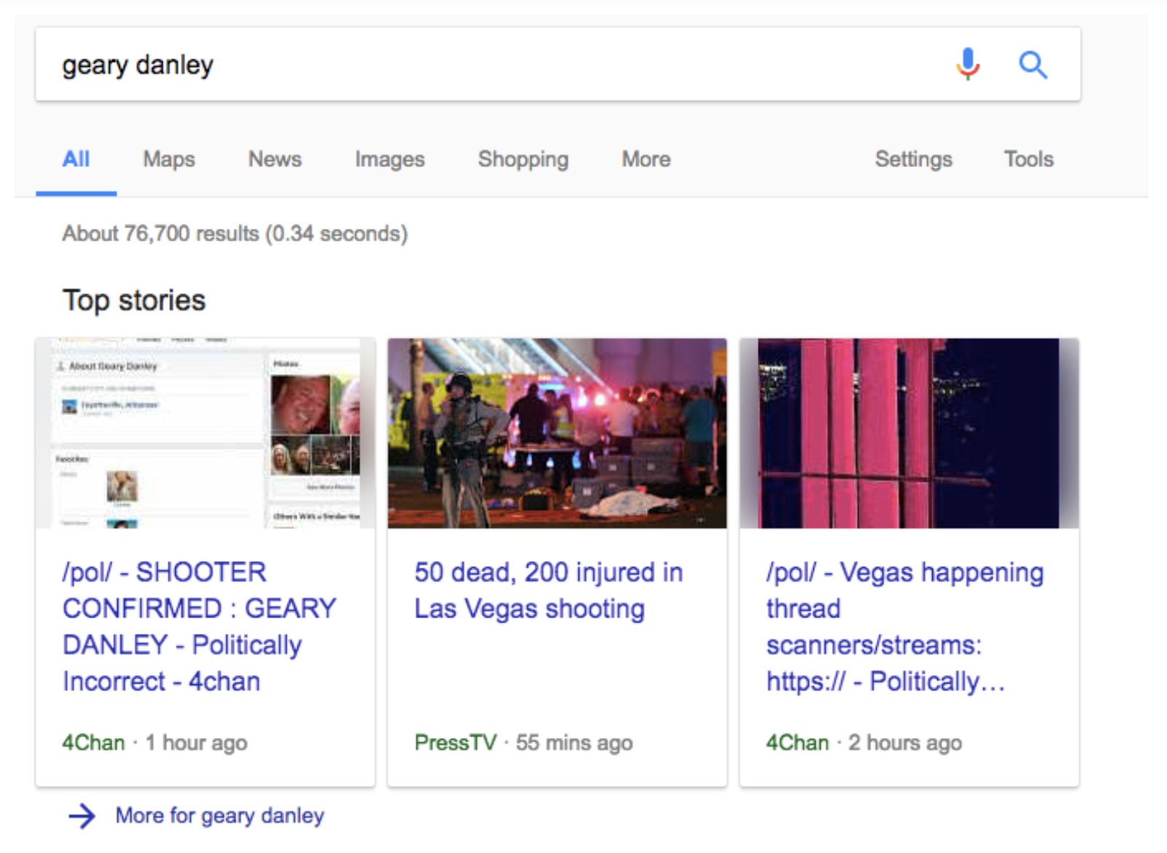
Algorithms have Material Consequences
Notes:
Jason

Slide 12
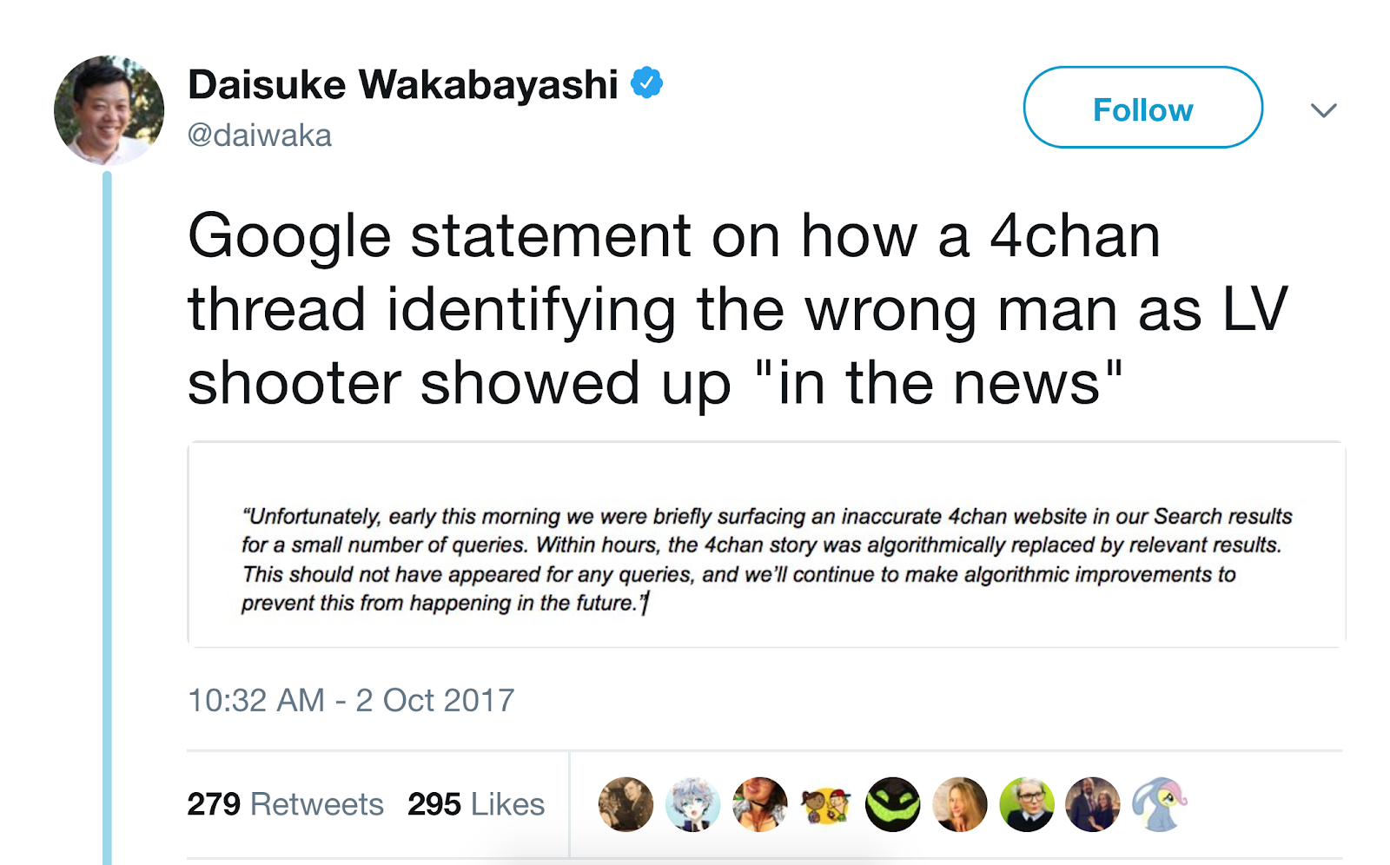
Algorithms have Material Consequences
Notes:
Jason

Slide 13
Awareness Outside Our Field
Statement on Algorithmic Transparency and Accountability (ACM)
https://www.acm.org/binaries/content/assets/public-policy/2017_usacm_statement_algorithms.pdf
Notes:
Jason

Slide 14
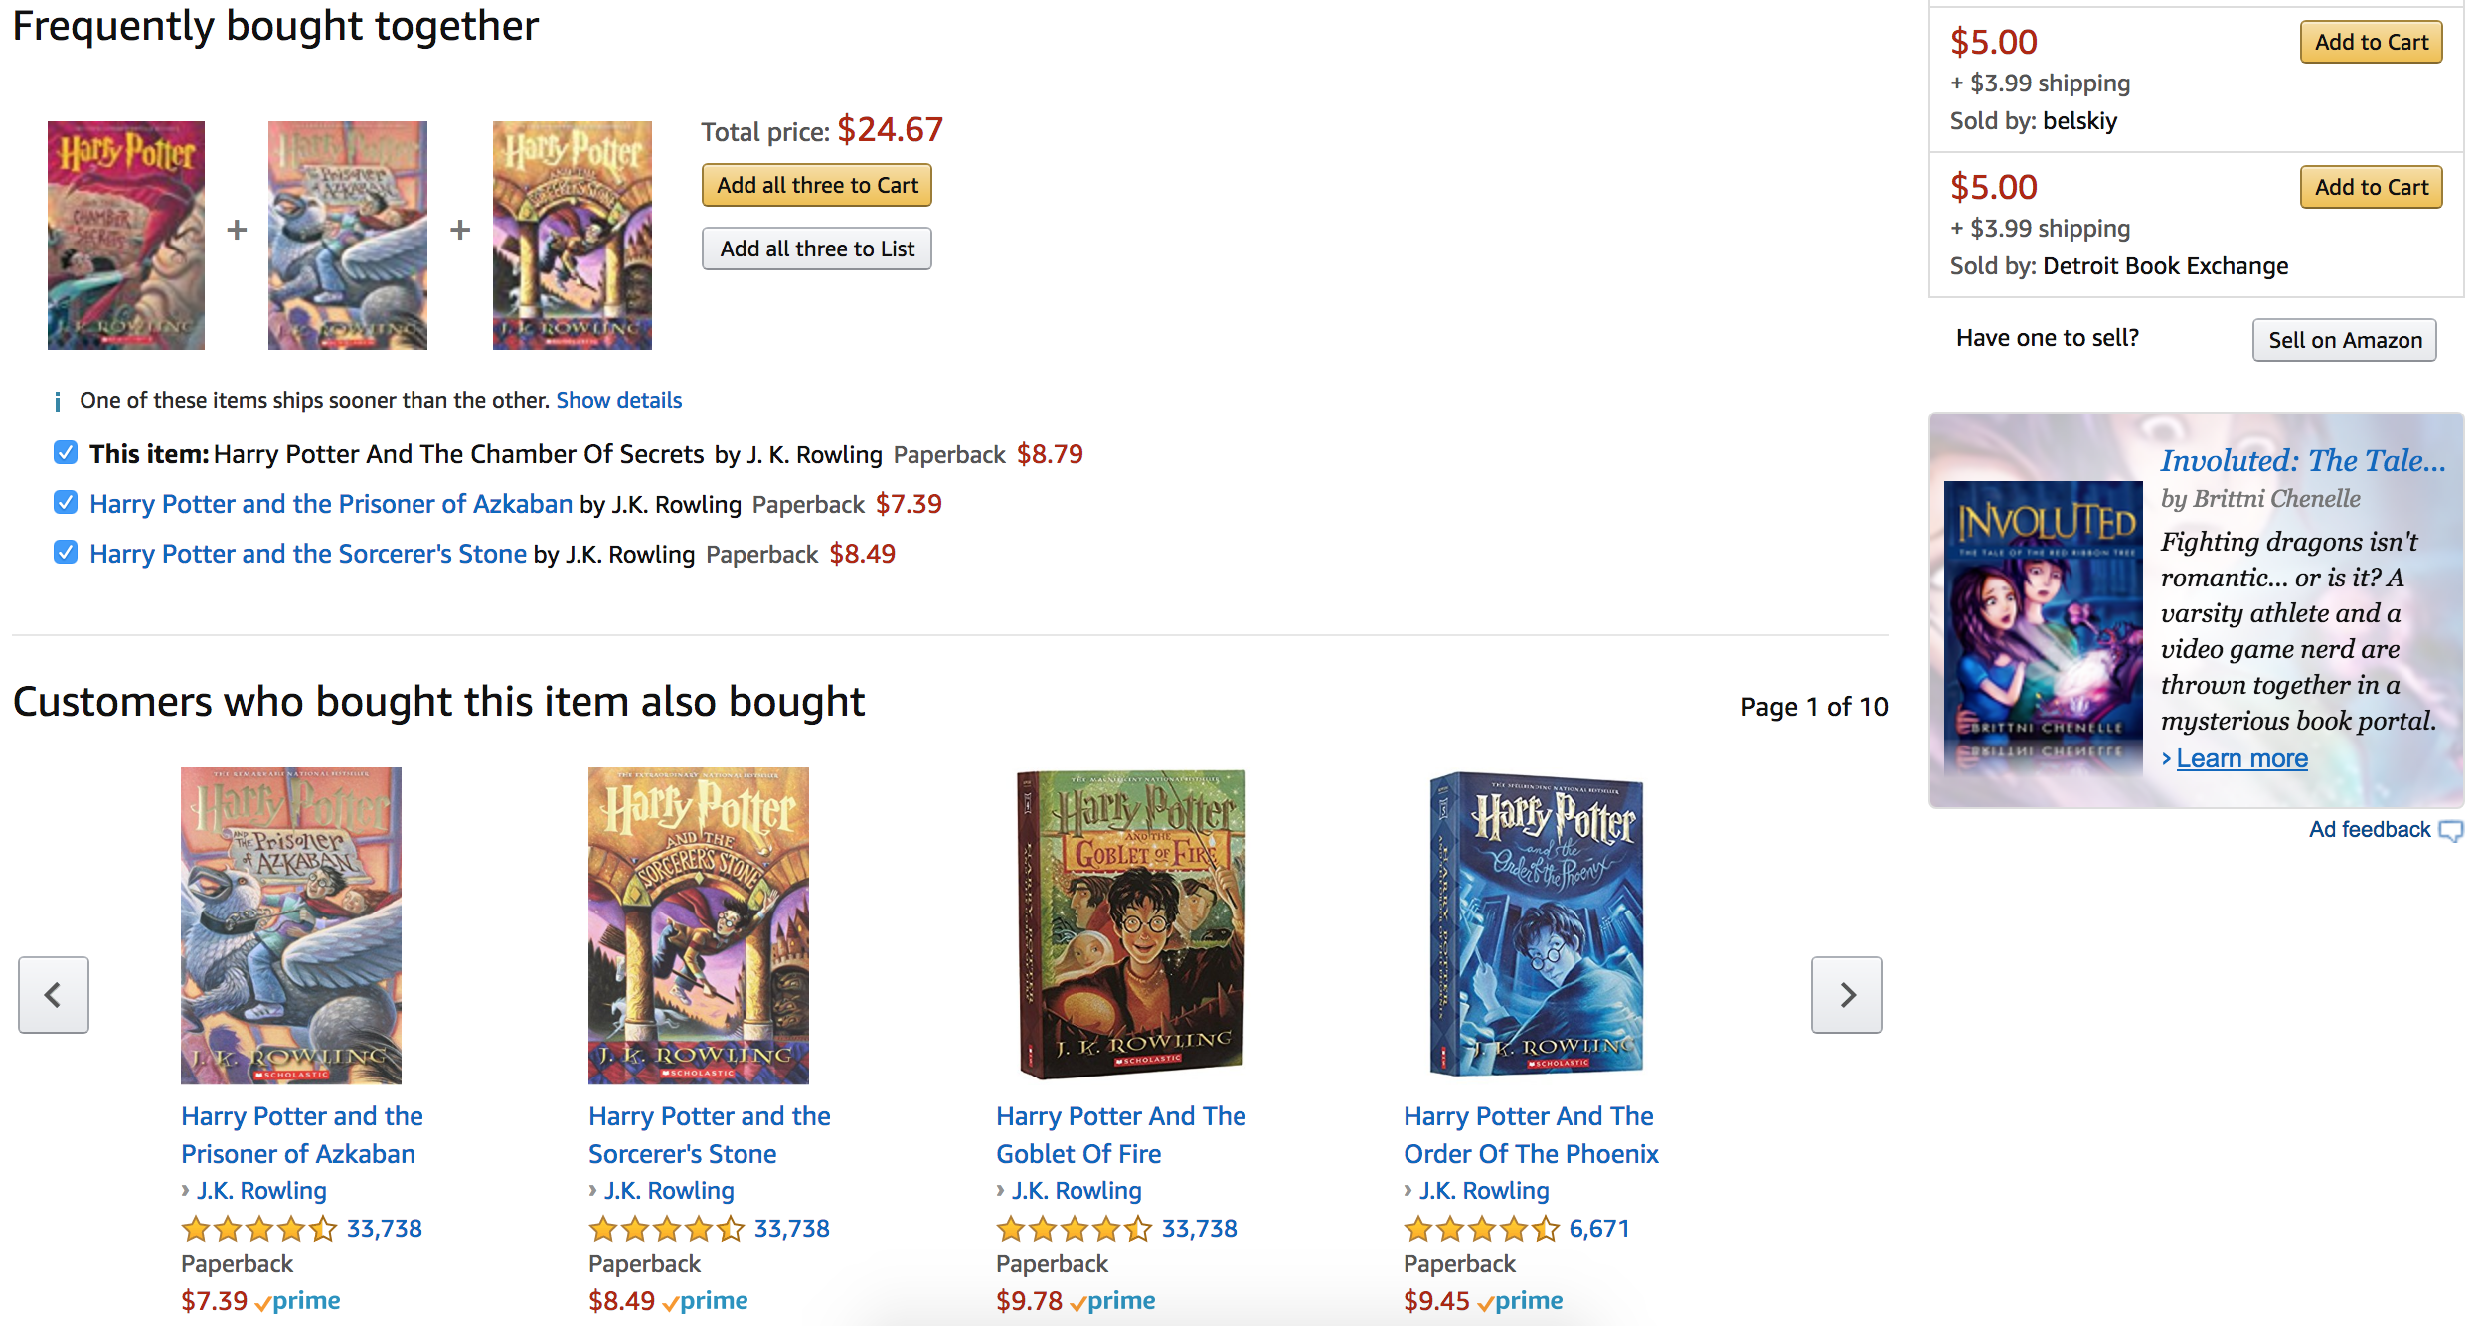
Notes:
Jason

Slide 15

Notes:
Jason
Top Picks:
Factors that may influence- genre, actors, previously watched movies, common actors, push for Netflix Originals

Slide 16
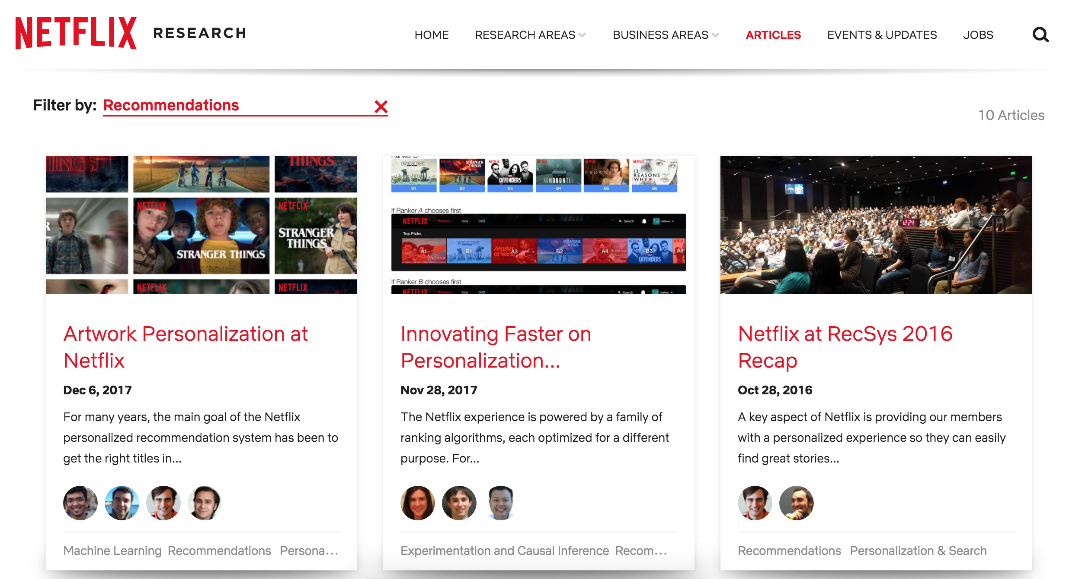
https://research.netflix.com/articles?q=Recommendations
Notes:
Jason
Top Picks:
Factors that may influence- genre, actors, previously watched movies, common actors, push for Netflix Originals

Slide 17

Notes:
Julian
Facebook Advertisements:
Factors that may influence: Previous searches (in my case, I was looking into hiking trails for this 4th of July weekend), what your friends like (ie, julia, terry, and 29 others), where you live/your zip code (recreation, Kalispell sales-where I'm originally from and where most of my friends are from), where your friends are from
Julian

Slide 18

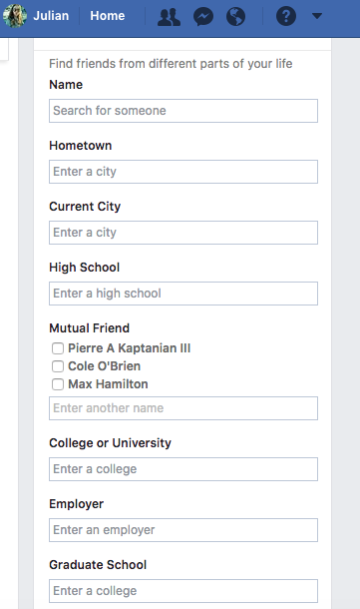
Notes:
Julian
Name, hometown, current city, high school, mutual friends, college or university, employer, graduate school, age, phone/other social media contacts

Slide 19
Algorithms in Action
Weighted Graph Network
https://en.wikipedia.org/wiki/Weighted_network
Dijkstra's algorithm
https://en.wikipedia.org/wiki/Dijkstra%27s_algorithm
Notes:
Jason

Slide 20
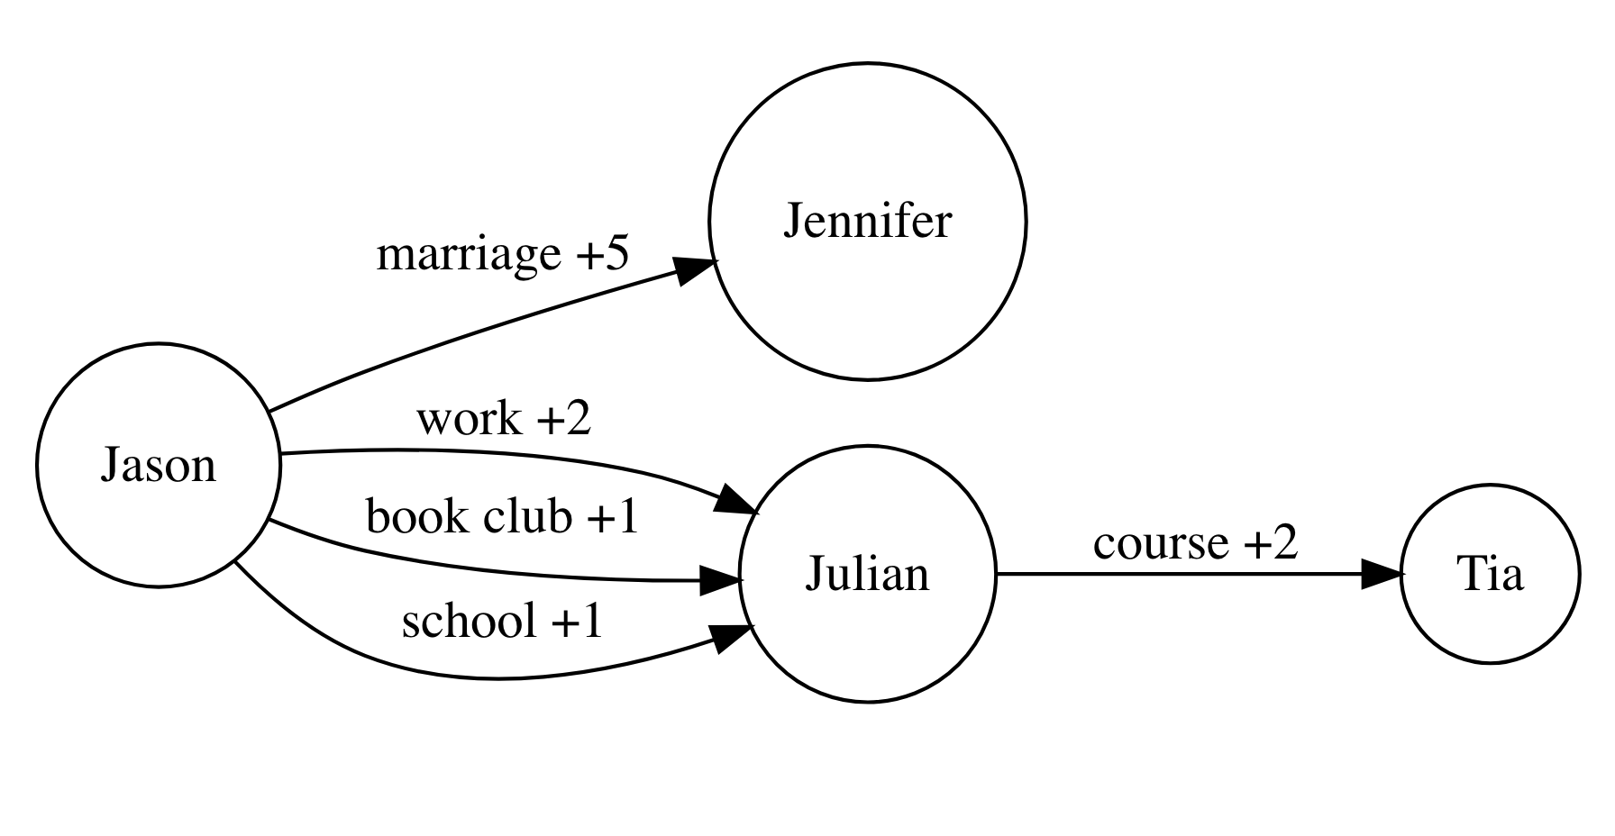
Notes:
Name, hometown, current city, high school, mutual friends, college or university, employer, graduate school, age, phone/other social media contacts
Jason

Slide 21
Teaching Tool
an "X-Ray" type search interface that demonstrates how different factors affect your search results
Location, weather, what else might be silently influencing?
E-Commerce experience: how likely are you to buy and what price do you see?
Implications
Notes:
Jason
We might want to include this if it's up and running! Cool demonstration
From WMD- the way someone sees prices depends on how likely they are to buy the product. For example, an airline ticket. If you've looked at a trip to Hawaii three times, are you more likely to buy now that you've been researching it? Perhaps you're more committed now and perhaps a bump up in price might be the factor that tips the scale so you buy before it's too close to the date you have a free weekend.
Another example of real world influence is US Today College ranking.
Jason

Slide 22
Teaching Tool (cont.)
an "X-Ray" type search interface that demonstrates how different factors affect your search results
Demo Application
Code for Demo Application
Notes:
Jason
We might want to include this if it's up and running! Cool demonstration
From WMD- the way someone sees prices depends on how likely they are to buy the product. For example, an airline ticket. If you've looked at a trip to Hawaii three times, are you more likely to buy now that you've been researching it? Perhaps you're more committed now and perhaps a bump up in price might be the factor that tips the scale so you buy before it's too close to the date you have a free weekend.
Another example of real world influence is US Today College ranking.
Jason

Slide 23
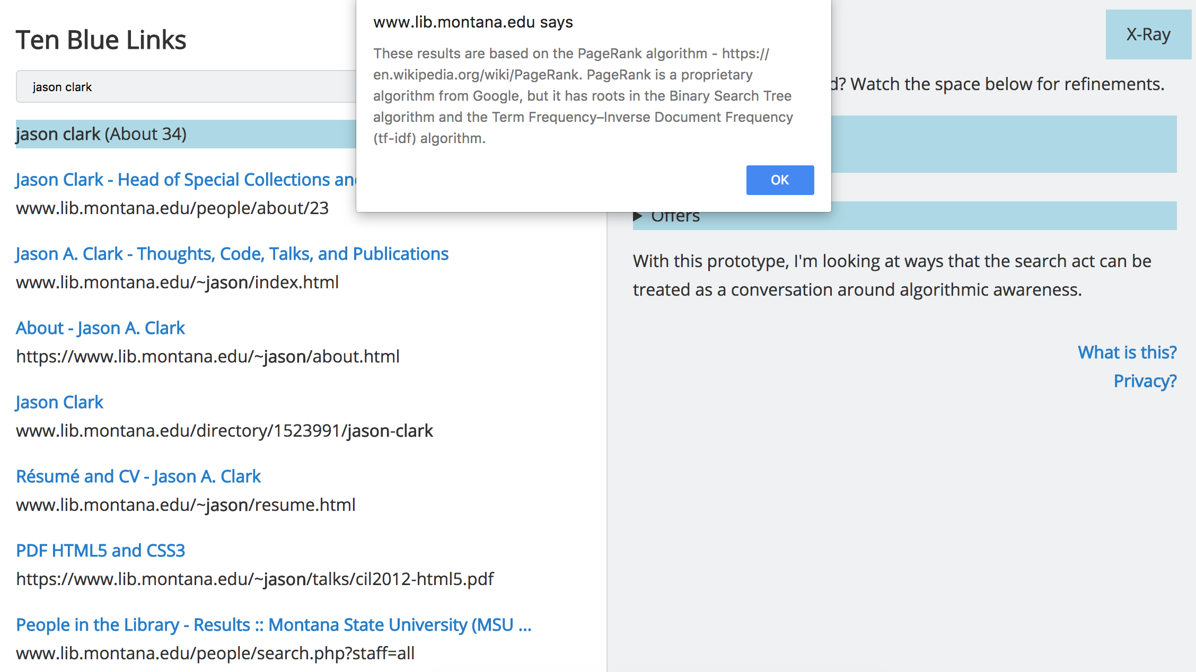
Notes:
Jason

Slide 24
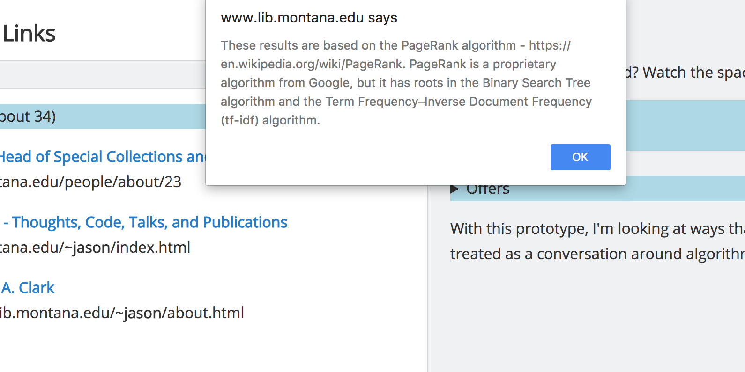
Notes:
Jason

Slide 25
ACRL Frameworks
Authority Is Constructed and Contextual
Information Creation as a Process
Information Has Value
Research as Inquiry
Scholarship as Conversation
Searching as Strategic Exploration
Notes:
Julian

Slide 26
Authority is Constructed and Contextual
"Information resources reflect their creators’ expertise and credibility, and are evaluated based on the information need and the context in which the information will be used. Authority is constructed in that various communities may recognize different types of authority. It is contextual in that the information need may help to determine the level of authority required."
Algorithms = “creator” informed by human decisions
But may hide behind an "unbiased façade"
Notes:
Julian
-for example how people are hired for

Slide 27
How Can we Teach These?
Create
Reference Materials
Practice
“Algorithmic Thinking”
Build
Tools with algorithmic transparency in mind
Establish
“ Algorithmic awareness” as a digital competency
Notes:
Julian

Slide 28
Break-Out Session: Programming the Library
We are going to ask you to program the different goals and actions of a library.
We will be practicing by putting these expressions into a computer program using a pseudo code language.
Notes:
Julian

Slide 29
Teaching Moment
theorized example of the workings of an algorithm
Give an introduction to coding
balance between technical and comprehensive learning
Notes:
Julian

Slide 30
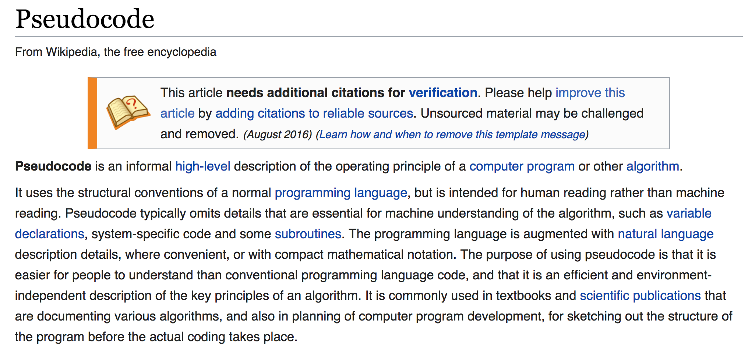
https://en.wikipedia.org/wiki/Pseudocode
Notes:
Julian

Slide 31
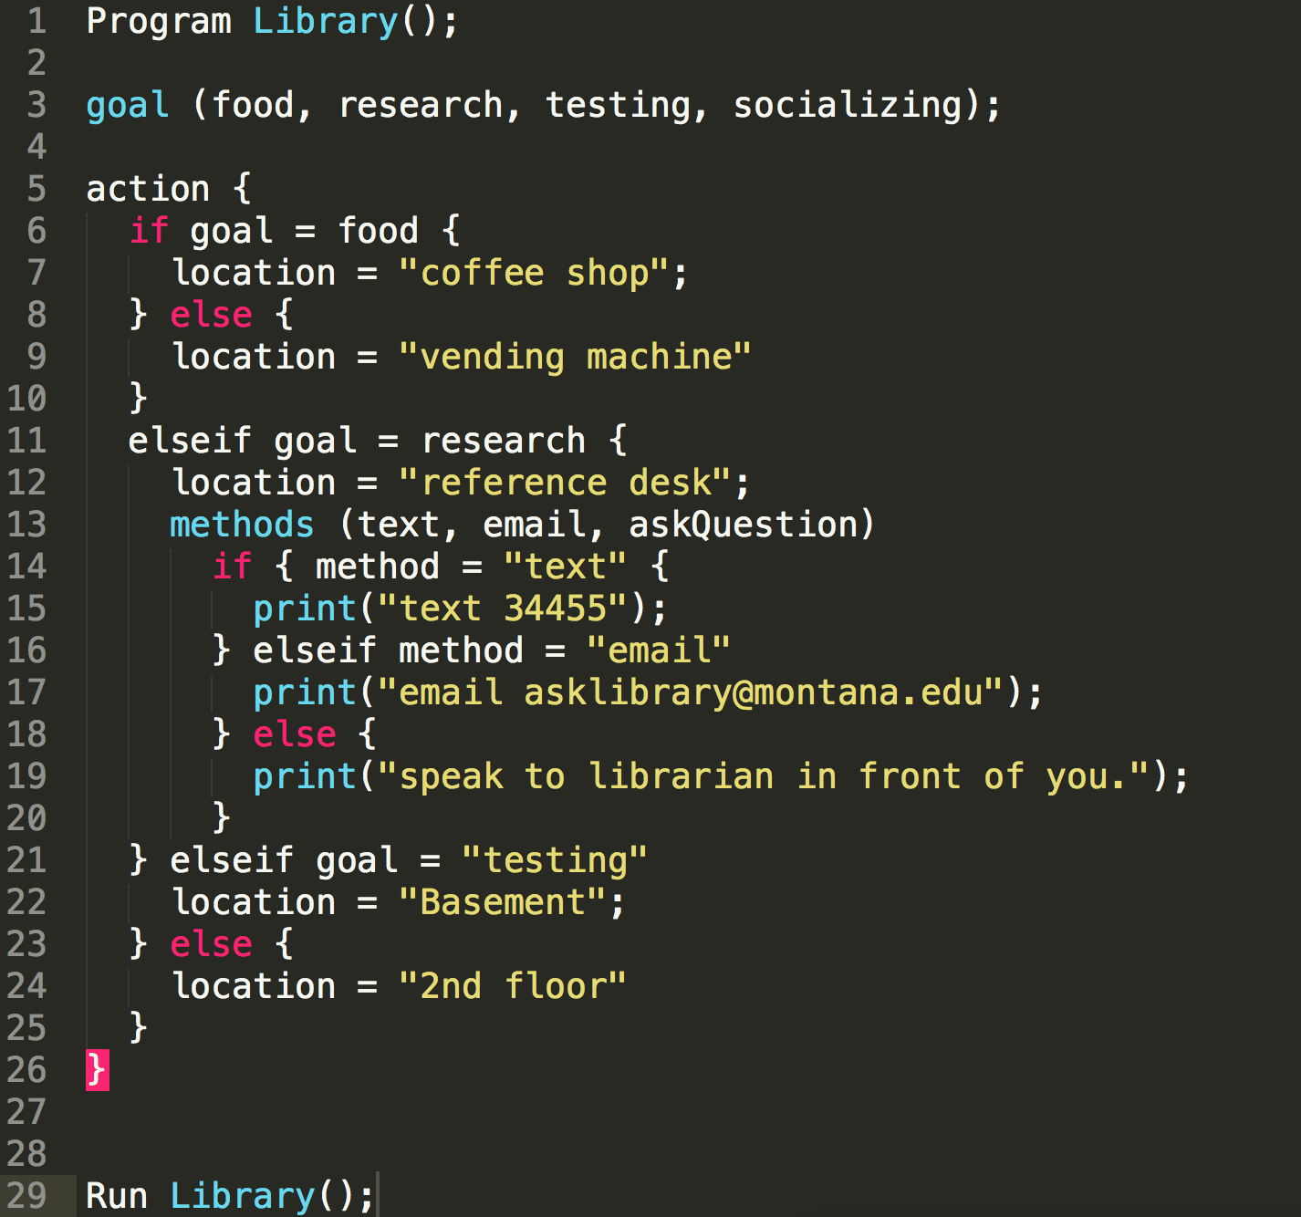
Notes:
Julian

Slide 32
Breakout Session: Steps
Open​ PseudoCode template in text editor
https://tinyurl.com/ycfgaj4f
Work through adding values and encoding decisions individually or with the person next to you (10 minutes)
*One goal is complex​, you will need to add methods.
Come back together to discuss (10 minutes)
Notes:
Julian

Slide 33
Discussion
Answer some questions
What were some goals?​
How did you decide on locations/actions?​
How do you view the role of a programmer and what are some challenges faced when creating algorithms?​
How is the algorithm different from human direction?​
How do you see bias in the algorithm you created?
Notes:
Julian

Slide 34
Questions?
Comments?
Notes:
Julian (The time should be 1 hour in so around 2:30)
Class Poll
What did you enjoy/find most educational about the class?
What could be change/improved upon in the next class?
What would you be most interested in learning about algorithms in the future?
What did you learn about algorithms?
Do you feel confident you could teach another person what an algorithm is?
clarity and organization
What class exercises worked best?
What class exercises did not work well?
Add survey questions: what class exercises worked best? What did not work well?

Slide 35
Optional Break
See you in 5 minutes!
Or finish up your code!
Notes:
Julian

Slide 36
Part 2: Application
Notes:
The time should be around 2:35

Slide 37
First Principles of Algorithms
Reference document listing
https://github.com/jasonclark/algorithmic-awareness/tree/master/workshop
Or https://tinyurl.com/ya33dhrz
Common algorithms
A brief overview of how they work
Some places you might find them
Notes:
Jason
reference document listing common algorithms and their placement (15 mins) - slides

Slide 38
Design Exercises
Get ready for some group activities!

Slide 39
SCAI Thinking - Overview
It might be easy to see the "Status Quo" and the "Ideal"
But what specific challenges might present themselves?
And how can one be empowered to get to those "Ideals"?
* Source: Design Research Working Group at Montana State University Library
Notes:
Jason

Slide 40
SCAI Thinking- Steps
Split into 5 groups of 4 to 5 people per group
Everyone goes to a flipboard and brainstorms/discusses for 10 minutes
10 minutes to present- 5 groups with 2 minutes each
**We've provided a bare bones example- feel free to add more rows and fill in or change our interpretations
Notes:
Jason

Slide 41
SCAI Thinking- Example
Status Quo | Challenge | Actions | Ideals
Inconsistent |  |  | Consistent
Ad-Hoc |  |  | Holistic
Complicated |  |  | Easy
Siloed | How do algorithms and algorithmic awareness fit into my field of expertise? |  | Integrated
Frustrating |  |  | Easy and Fun
Individual | I don’t have the knowledge, where do I get it? | Reach out to other faculty on campus | Network
Notes:
Jason
Split into 5 groups of 4 to 5 people per group
Everyone goes to a flipboard and brainstorms/discusses for 10 minutes
10 minutes to present- 5 groups with 2 minutes each

Slide 42
SCAI Thinking- Group Presentation
Each group has 2 minutes to present!
A few ideas on what to talk about...
What was your favorite examples?
What was most challenging to solve?
How might this exercise be incorporated into a lesson plan?
Notes:
Jason

Slide 43
Stakeholders Map Who are your partners?
Mathematics
Statistics Department
Calculus Prof
Computer Science
Lab
Software developers
Library
Technical clarification
Class activity ideas
How does this work?
Notes:
Jason

Slide 44
Questions?
Before we move on to our last exercise!
Notes:
Jason

Slide 45
Lesson Plan- Overview
"Create actionable steps for teaching about algorithms in information literacy instruction"
Feel free to incorporate the other breakout sessions
Now it's your turn!
How can you take algorithmic awareness and incorporate your skills and expertise while teaching others?
Notes:
Jason

Slide 46
Lesson Plan- Exercise
10 Minutes individual brainstorming
Get into groups of 4 or 5 people
15 Minutes small group discussion
15 Minutes large group discussion
**Each group has about 2 minutes to present
Notes:
Julian

Slide 47
Lesson Plan- Template
A lesson plan could be anything! A two hour workshop, a three hour presentation, or one class in a semester long course- this is for you!
https://tinyurl.com/ybhtojym
Make sure to download and create your own lesson plan
Notes:
Julian
Available online and have printed out copies
*Convert to Google Doc***

Slide 48
Lesson Plan- Group Discussion
Each group has two minutes to present some
Ideas
Challenges
Ways they incorporated their field of expertise
Or pretty much anything!
Notes:
Jason

Slide 49
Thank You
Final Questions?
Feel free to chat with us more outside!

Slide 50
Resources
Document and Code Repository
github.com/jasonclark/algorithmic-awareness
Contact Info
Jason: jaclark@montana.edu
Julian: jkaptanian@gmail.com

